Slide 1

Lend ngClub
A Peer-to-Peer Loan Analysis
Team 1
Jonathan Schild
Medhasweta Sen
Brian Gulko"

Slide 2

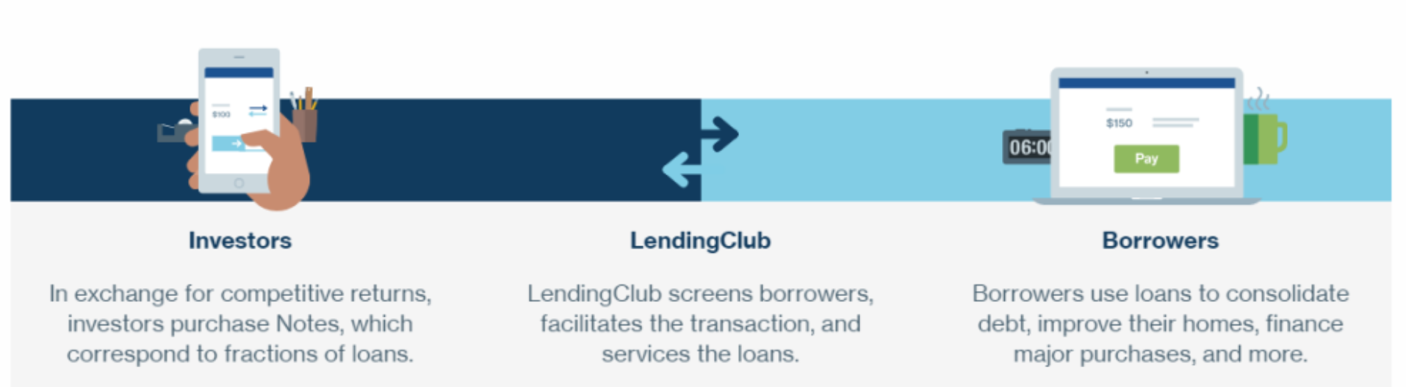
What is LendingClub
Source: https://www.moneysmylife.com/lendingclub-review/
Notes:
Peer-to-peer (P2P) was a phenomenon less than ten years ago, exploding in popularity by offering a break from traditional banking. Individuals flocked to the alternative credit markets as alternative sources of funding and for new opportunities to finance their small business ventures.
Although direct P2P lending has undergone changes over recent years, it remains a viable option for borrowers and investors. We are seeking to understand the factors that might have signalled risky loans or borrowing practices and could be consumed or applied by prospective borrowers, lenders, and/or investors considering participating in direct P2P.

Slide 3
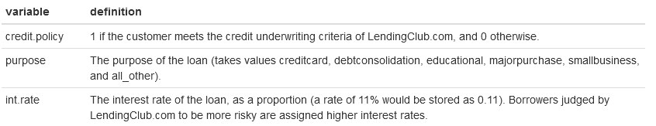
Our Data
9,578 observations
14 variables
.
.
.
.
.
https://www.kaggle.com/datasets/urstrulyvikas/lending-club-loan-data-analysis
Notes:
Our dataset contains over 9,500 observations of loan data from LendingClub, the largest online platform for direct P2P lending.¹ We believe that the timeframe of 2007 to 2015 provides the most relevant data for prospective individual investors today, particularly because it is unlikely to include a significant number of large institutional lenders.

Slide 4
EDA Process
EDA Steps
Formulate our question
Read in our data
Check the packaging
Look at the top and the bottom of your data
Check your “n”s
Validate with at least one external data source
Make a plot
Try the easy solution first
Follow up
SMART Question
Source: Chapter 4, The Art of Data Science
Notes:
Our exploratory data analysis will adhere to the 9-step² checklist presented in Chapter 4 of The Art of Data Science.³ These are the elements of our checklist.
QUESTION: Our analysis explored things such as income-to-debt ratios, credit score, interest rates, and delinquencies among direct P2P borrowers in an attempt to understand the risks and opportunities associated with P2P. Specifically, we intend to examine the impact that these variables have on who received loans and who defaulted on their loans between 2007 and 2015.

Slide 5
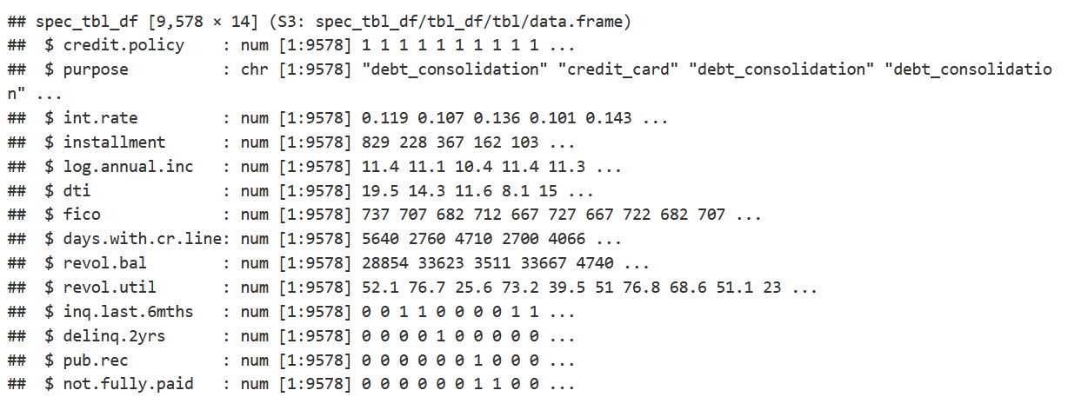
EDA – Structure
Source: https://www.moneysmylife.com/lendingclub-review/
Notes:
After reading in our dataset and taking a look at the structure, we can see that it contains 9578 rows of data with 14 columns. We can also see that most of our variables are of the numeric data type.
One thing we noted at this point while checking for blanks, or NAs, and wrongly formatted data, was the ‘like-logical’ nature of the last few variables but we’ll come back to that in a second.

Slide 6
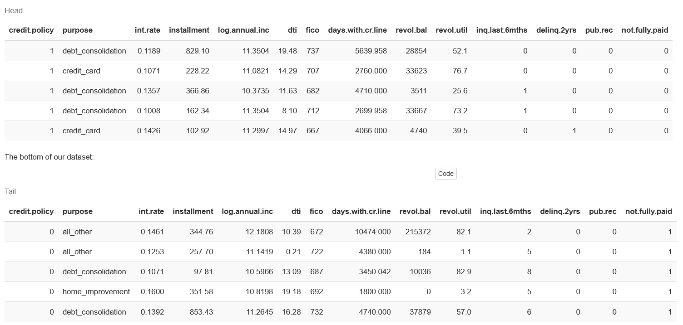
EDA – Top & Bottom of Dataset
Notes:
We also took a quick glance at the top and bottom of our dataframe, which indicates the data is structured in an acceptable way and that our variables match up with the appropriate data types and values for each column.

Slide 7
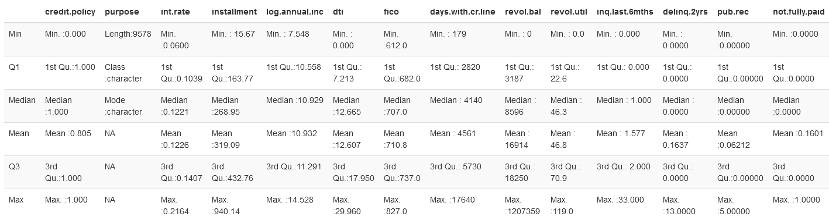
EDA – Summary
Notes:
We got the basic descriptive statistics of the variables to improve our understanding of the data and help give us an idea of what we could expect further down ling. This also confirmed for us that those few variables that were possibly logicals are not and our analysis won’t be disrupted by any TRUE or FALSE values.
We gauged the reliability of our data by comparing some of our variables against what we would expect to see. For example, interest rates for the data are between 6% and 21.64% and credit scores range from 612 to 827. Although interest rates might seem to reach excessively high rates or credit scores too meager, the P2P market tended to consist of more risky loans. This aligned with our expectation and reinforced our confidence in the dataset.
The range of the utilization, or the percent of credit being used, is between 0% and 119%. Someone utilizing more than 100% of the credit available to them initially seemed erroneous; however, this can occur from technical error, creditors and collectors reporting at different date/times, borrowers opening and closing credit lines, or possibly when borrowers appear as authorized users of others’ credit lines. Regardless, only 27 loans within our dataset appear to exceed the standard maximum of 100% so we do not expect this to have a significant effect on our analysis.
According to the Kaggle site where we got this dataset from, there are 9,578 rows and 14 columns, which matches what we have. The site also shows that there is no missing data. Let’s verify that by adding the total number of missing cells in the dataset, which is 0.

Slide 8
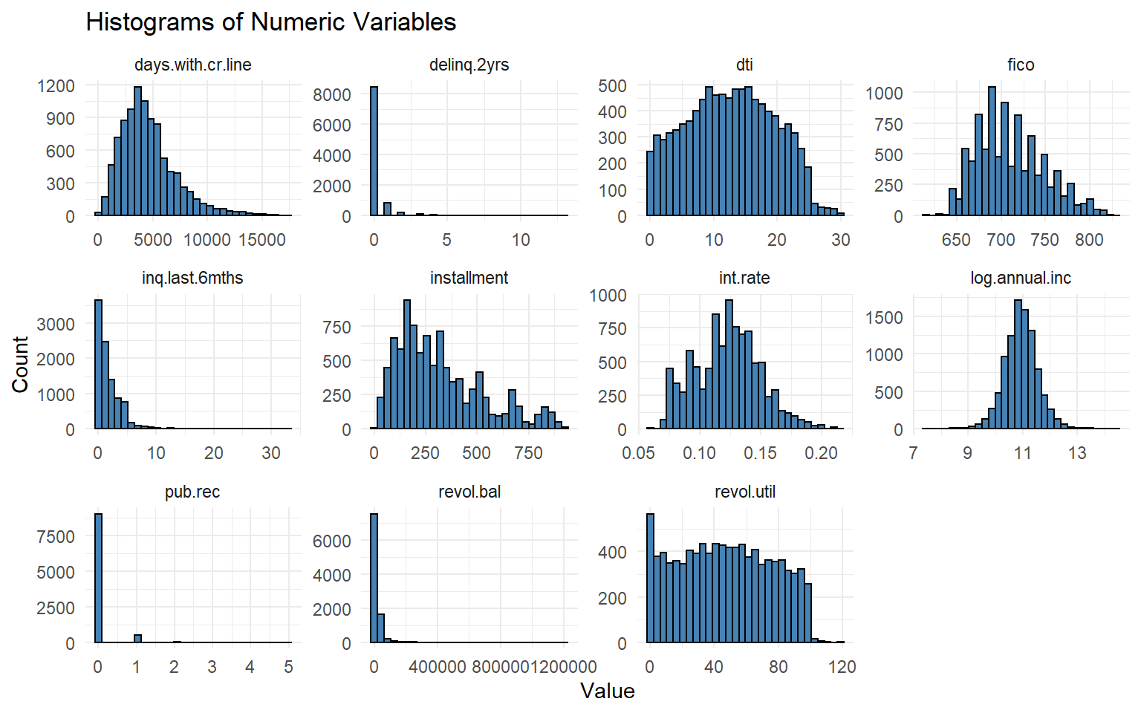
EDA – Histograms
Notes:
Some of these variables look somewhat normal, and it would make sense to create a QQ-Plot for them later.

Slide 9
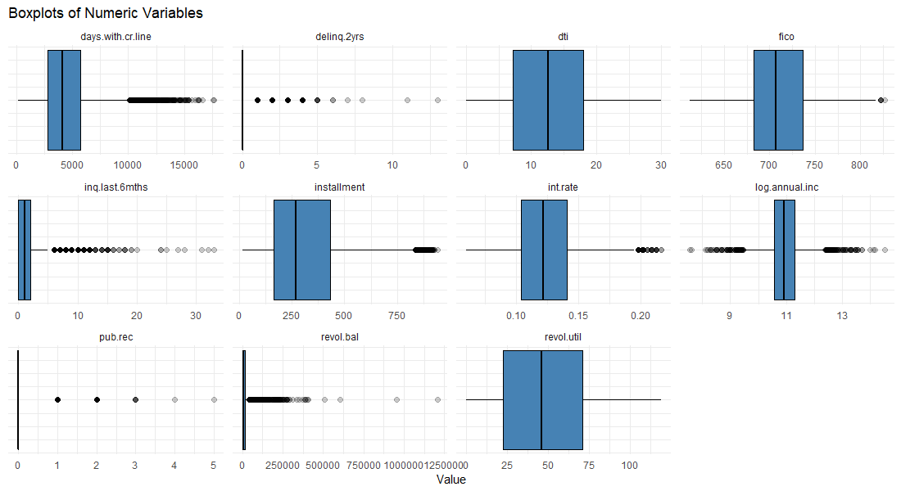
EDA – Boxplots
Notes:
We can see that some of these variables have issues with outliers.

Slide 10
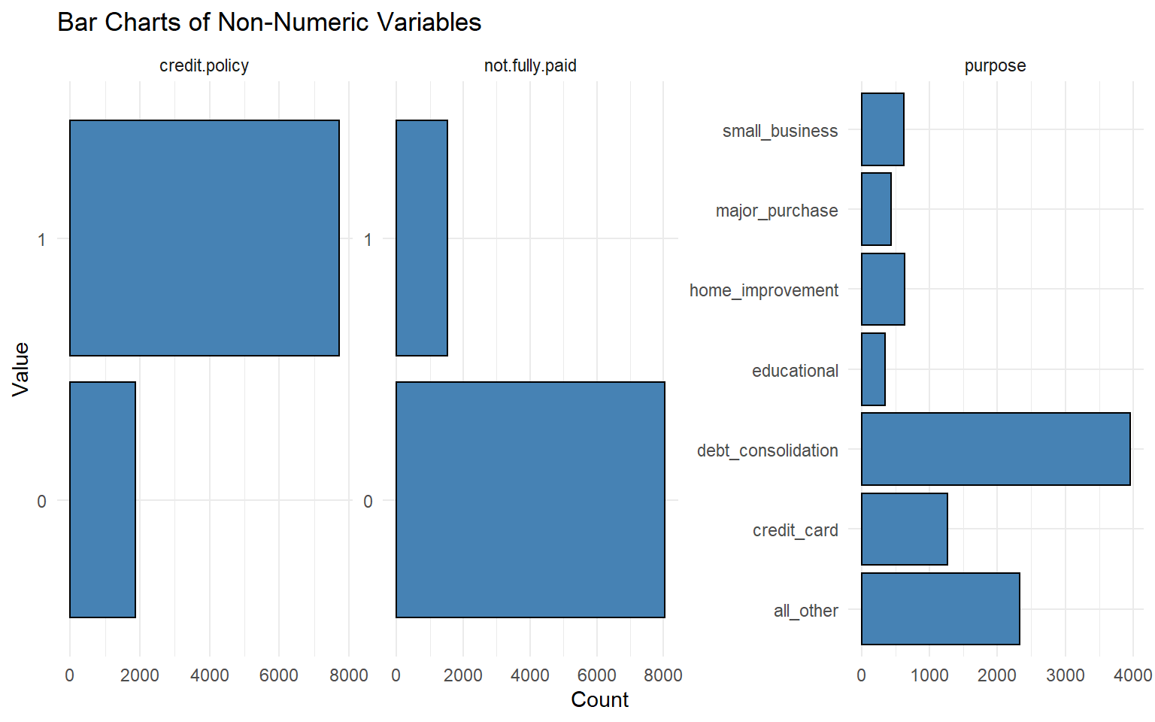
EDA – Bar Charts
Notes:
From this we can see that the purpose variable would be a good candidate to perform ANOVA tests on.

Slide 11
EDA – The Easy Way
Credit Policy | Percent Not Fully Paid
0 | 27.8%
1 | 13.2%
Notes:
From this we can see that about 13.2% of borrowers who met the credit underwriting criteria did not fully pay, while for the borrowers who did not meet the credit underwriting criteria about 27.8% did not fully pay.
This indicates borrowers who did not meet the credit underwriting criteria were almost twice as likely to be default on their loans than those who did meet the criteria. For comparison, default rates on loans from commercial banks for the same period as our dataset averaged 4.48%, with a maximum default rate of 7.49% default rate towards the end of 2009, according to the St. Louis Federal Reserve Bank.

Slide 12
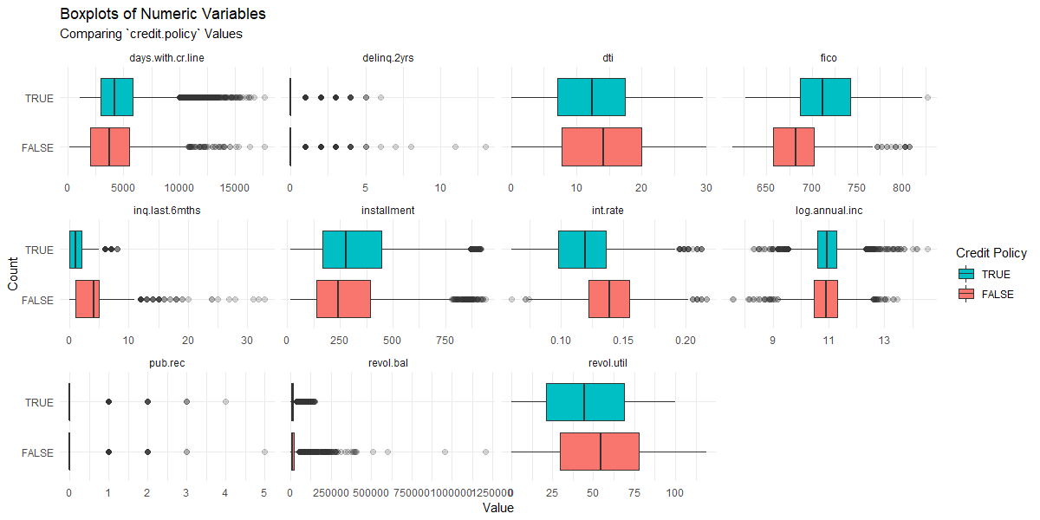
EDA – Additional Boxplots – 1 of 3
Notes:
Let’s also convert some of the variables to a more appropriate type. the credit.policy and not.fully.paid variables are logicals, and the purpose variable we will use as a factor.
Now we can further explore the data to see how the numeric variables differ based on the on the credit.policy, not.fully.paid, and purpose variables. Let’s make some boxplots to visualize this.

Slide 13
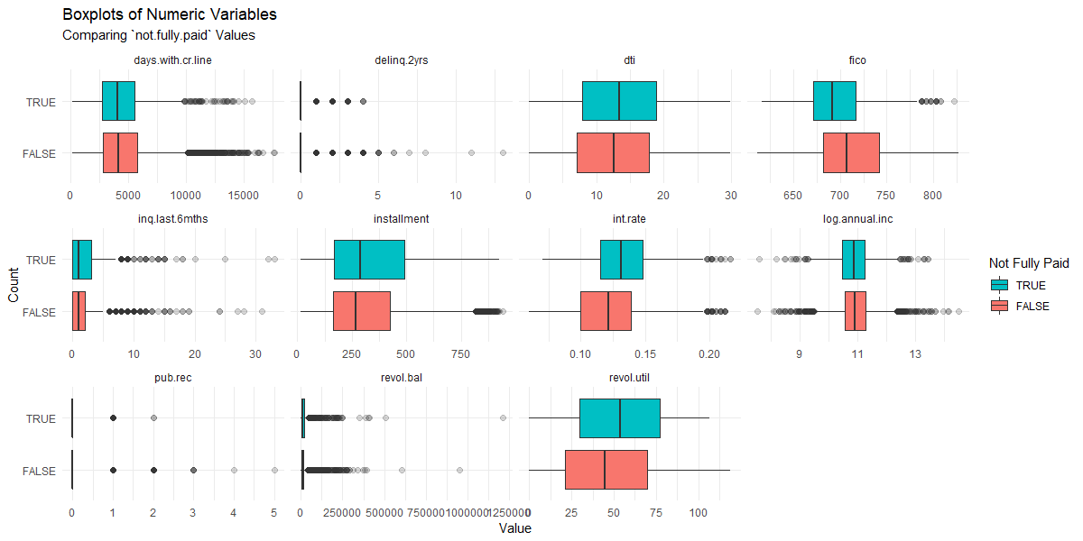
EDA – Additional Boxplots – 2 of 3

Slide 14
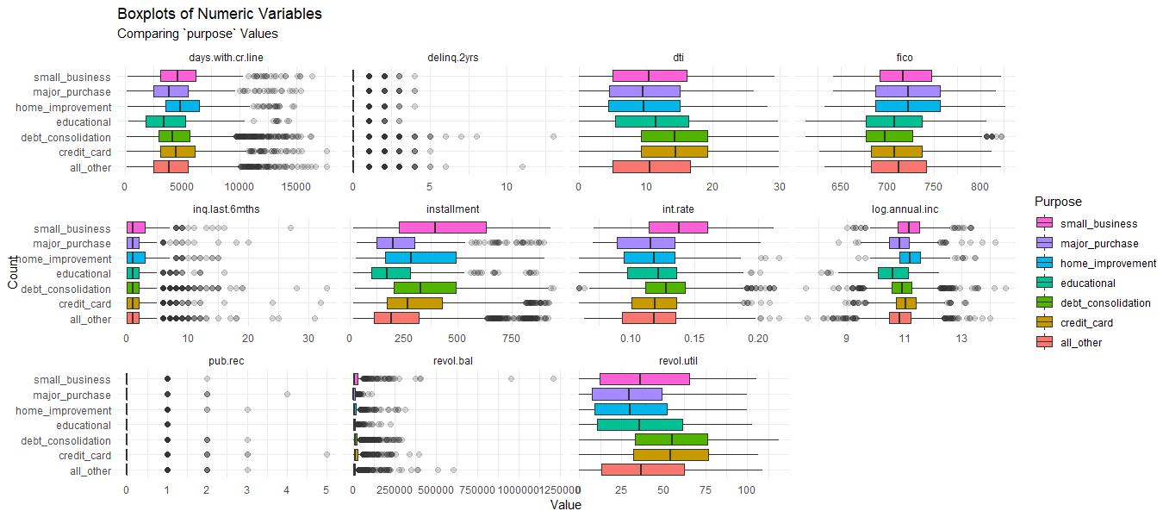
EDA – Additional Boxplots – 3 of 3

Slide 15
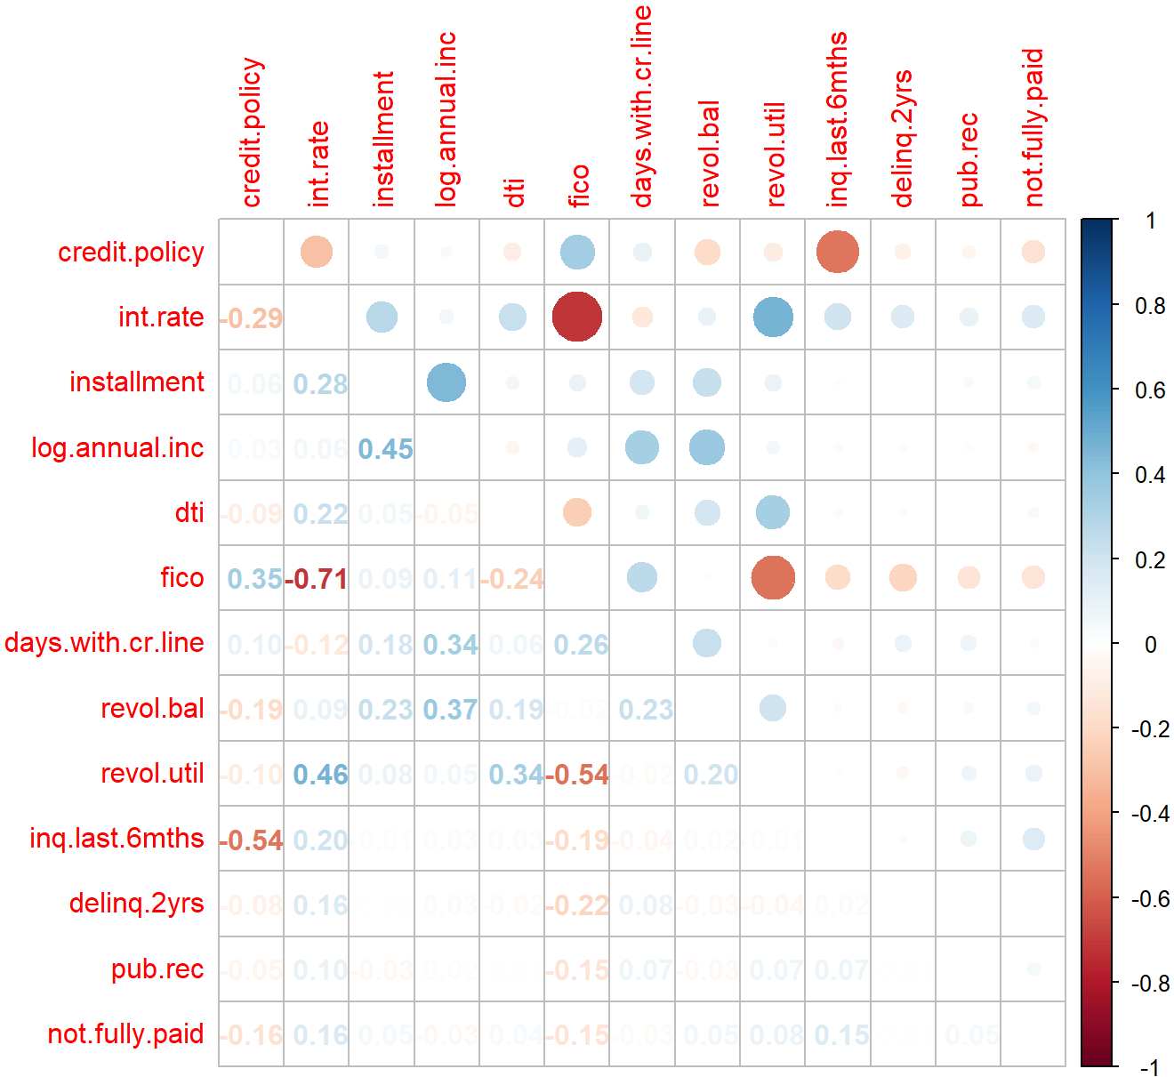
Correlation Matrix

Slide 16
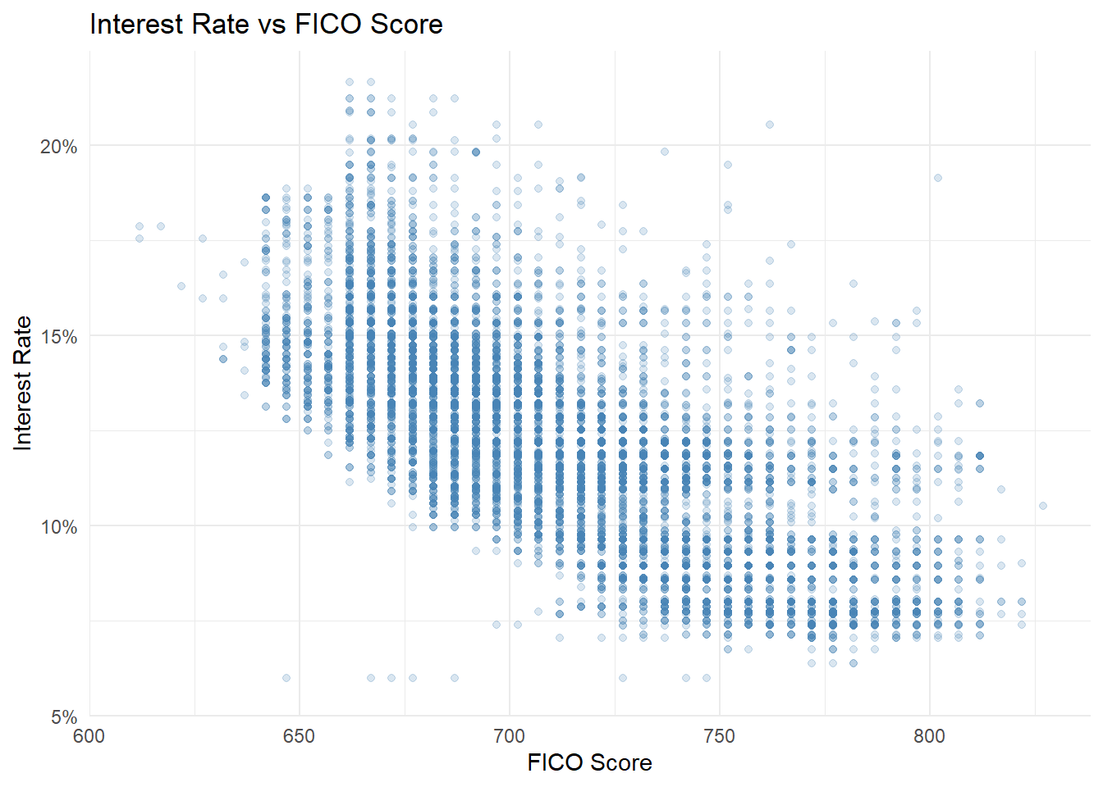
Scatter Plots – 1 of 4

Slide 17
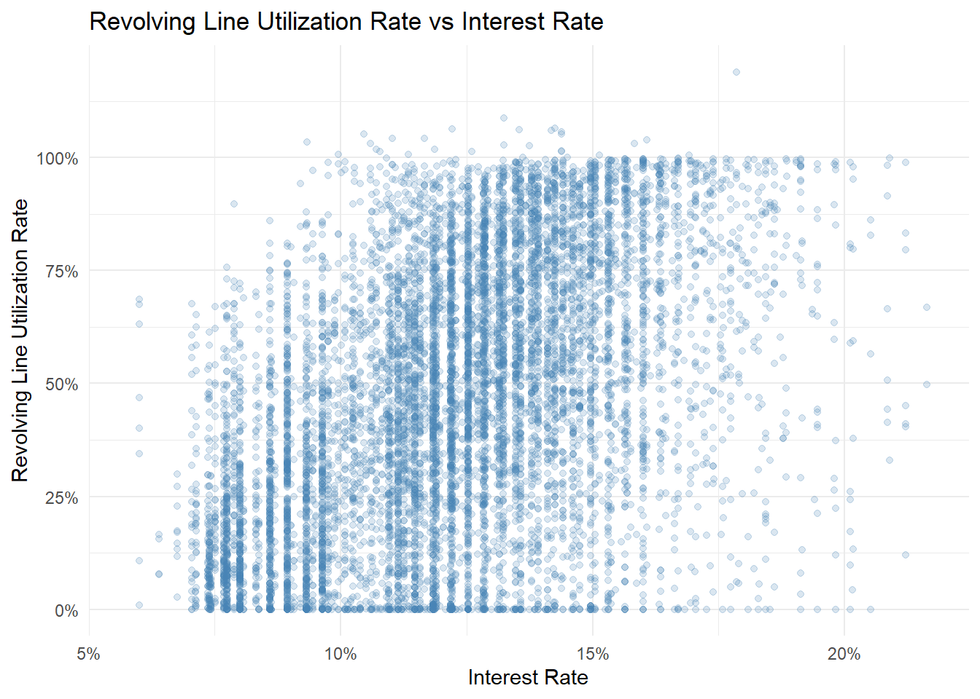
Scatter Plots – 2 of 4

Slide 18
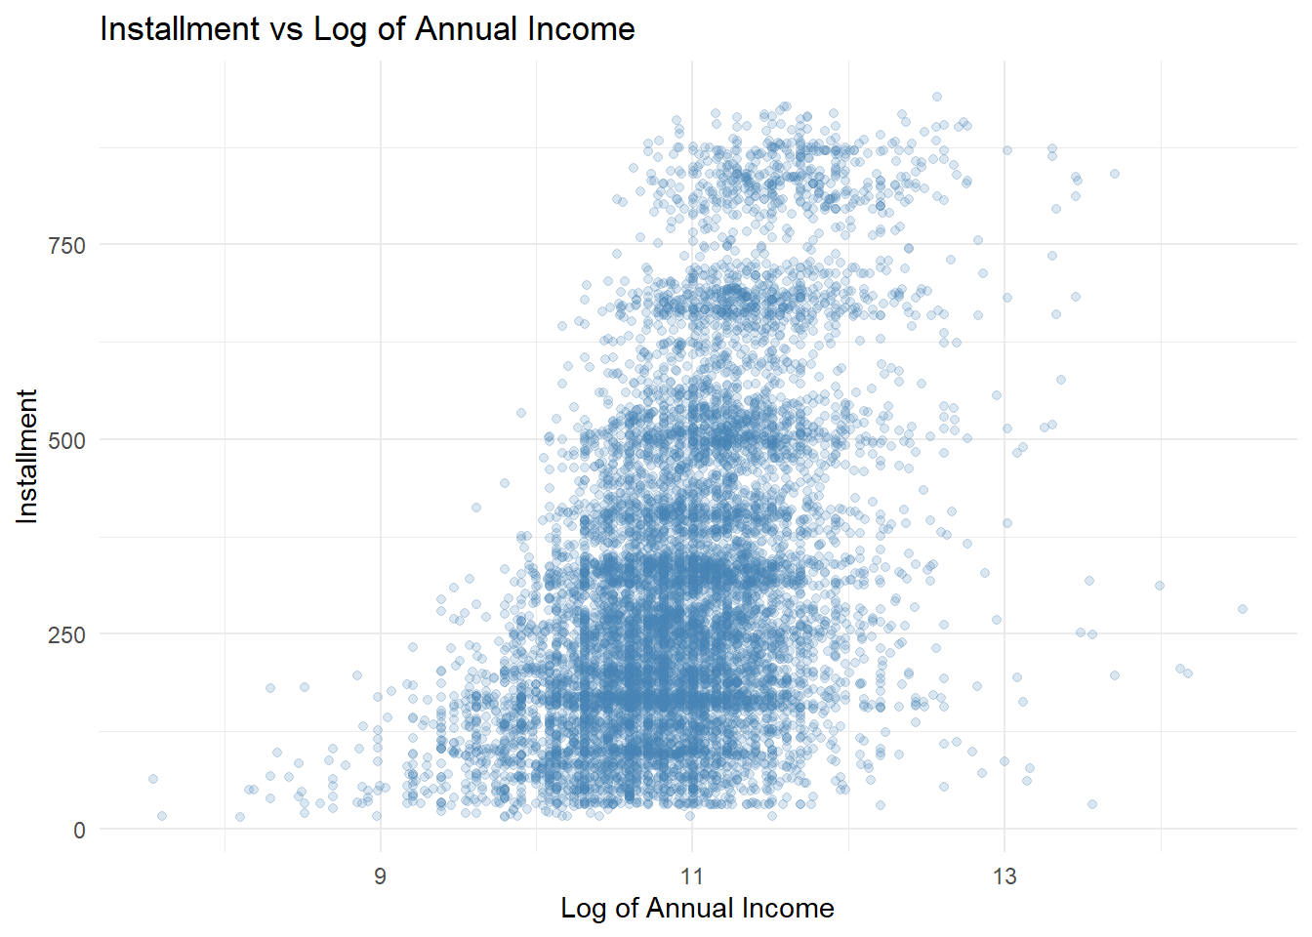
Scatter Plots – 3 of 4

Slide 19
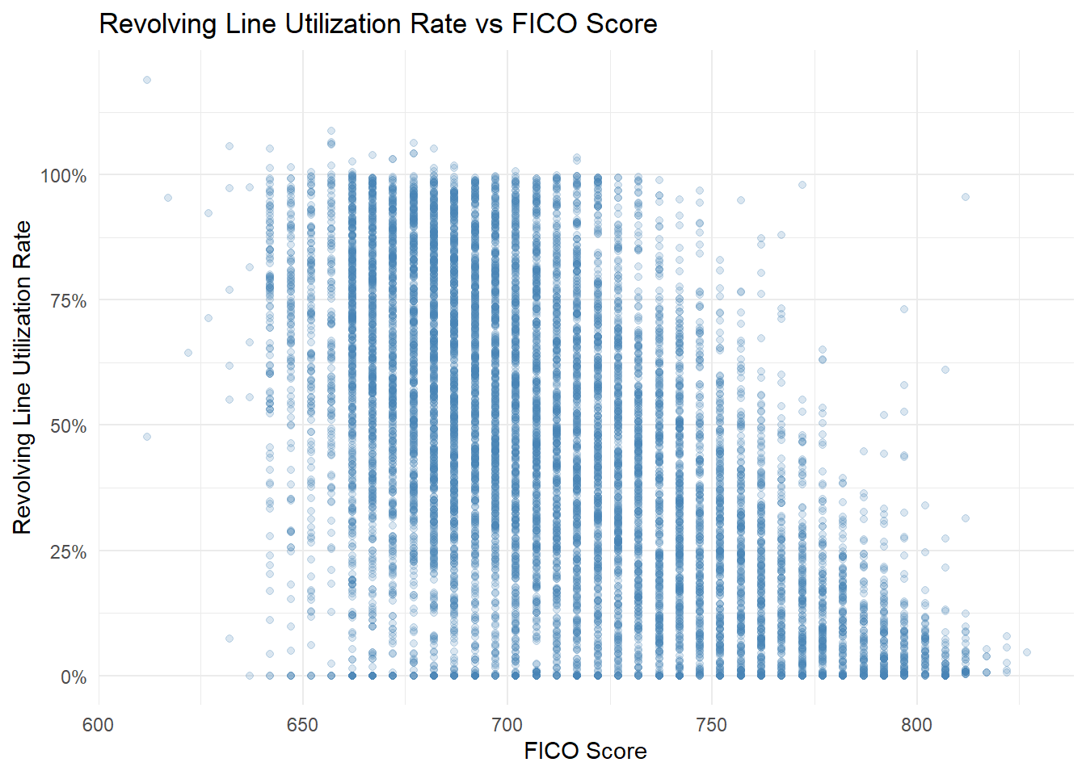
Scatter Plots – 4 of 4

Slide 20
Statistical Tests

Slide 21
Statistical Tests

Slide 22
Statistical Tests

Slide 23
Conclusions and Next Steps

Slide 24
Questions?

